Slide 1
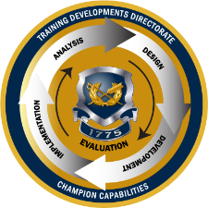
TJAGLCS Training Package
Contracting Officer Representative Authorities
December 2024

Slide 2
The information provided throughout this training aid does not, and is not intended to, constitute legal advice; instead, all information, laws, statues, content, and materials for this training aid are for general informational purposes only. This training aid may not constitute the most up-to-date legal or other relevant legal information. Judge Advocates need to conduct their own due diligence through independent further legal research on any specific legal issue contained in this training package. No reader, user, or trainee of this product should act or refrain from acting based on information from this training aid without first seeking legal advice from an attorney in the relevant jurisdiction.

Slide 3
Contracting Officer Representative Authorities

Slide 4
Key Resources
Army Regulation 70-13, Management and Oversight of Service Acquisitions, 30 July 2010
Administrative Instruction 105, Office of the Director of Administration and Management, 13 July 2023
Defense Contract Management Agency Manual 4301-13, Change 2, 24 June 2024
Federal Acquisition Regulation (FAR) Section 1.604, Contracting Officer’s Representative
Defense Federal Acquisition Regulation Supplement (DFARS) Clause 252.201-7000, Contracting Officer’s Representative.
Army Federal Acquisition Regulation Supplement (AFARS) 5101.602-2-91, Contracting Officers Representative Appointments.

Slide 5
Overview: FAR 1.604

Slide 6
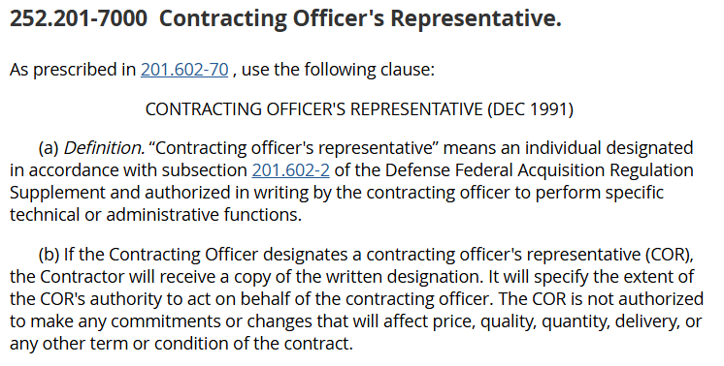
DFARS 252.201-7000

Slide 7
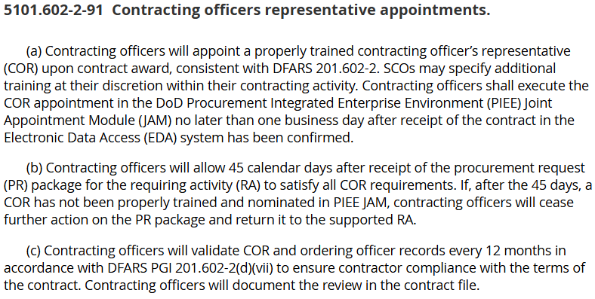
AFARS 5101.602-2-91

Slide 8
COR Designation: Sample
AFARS 5153.303-1: Pursuant to DFARS 201.602-2
Authorized actions to be taken for the contract and period
Monitor contract performance
Coordinate site entry
Designation is for the life of the contract, unless revoked in writing by the Contracting Officer
Required to maintain adequate records to sufficiently describe performance of their duties
Required to summarize contractor performance at least annually

Slide 9
Need Training Materials?
Have Training Materials?
Questions?
Contact Us!
TJAGLCS-training@army.mil

